Slide 1
WANTS
FRAMEWORK
Mustafa M Yildiz
April, 2026

Slide 2
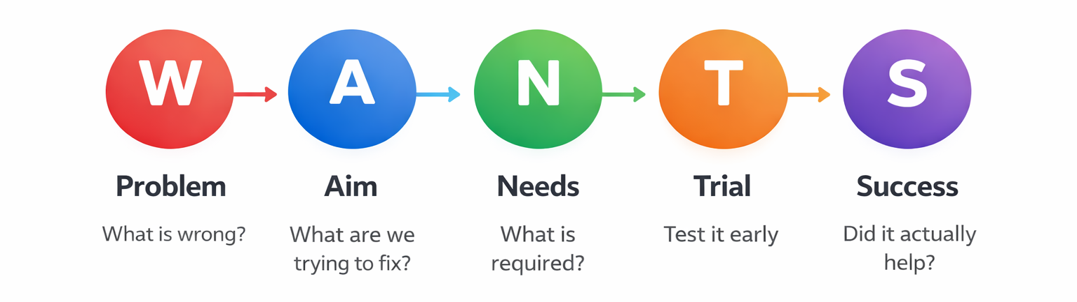
The Core Idea. The wants framework is give the user what they want.

Slide 3
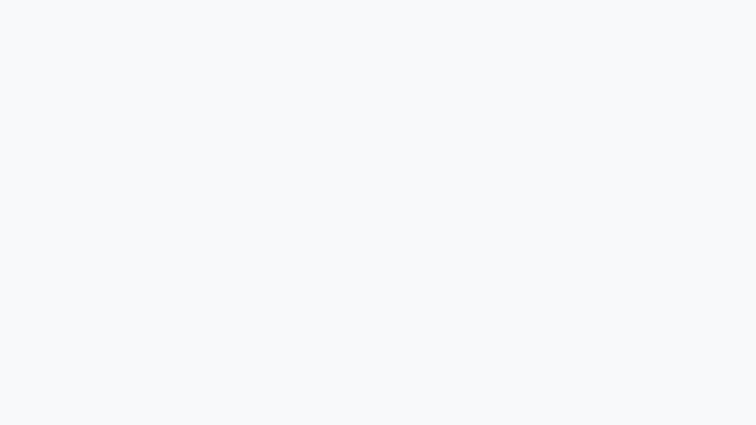
Implementation Plan: WANTS Framework
01
02
03
Step 1:
What is the problem?
Step 2:
Aim
Step 3:
Needs of the user
What is currently frustrating or slow?
Where are users getting stuck?
What is not working right now?
What are we trying to improve?
What does success look like?
What should change for the user?
What does the user actually want?
What matters most to them?
What do they expect from this solution?

Slide 4
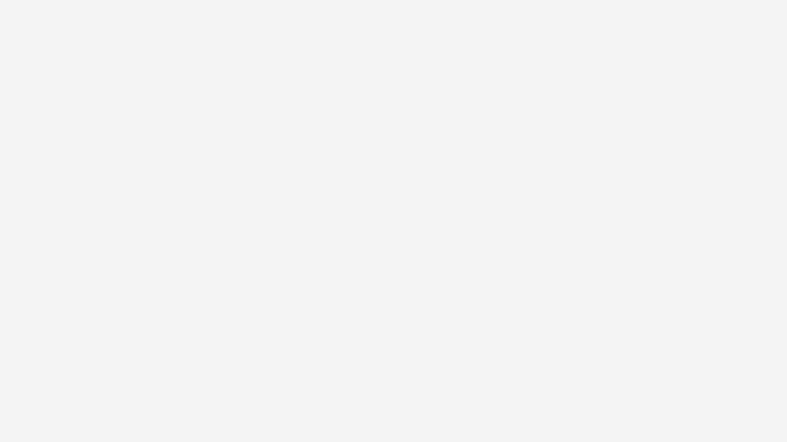
Implementation Plan
04
05
Step 4:
Trial & Testing
Step 5:
Success
• Test a simple version of the solution
• Observe real user behavior
• Adjust based on feedback
• Did the solution fix the problem?
• Are users satisfied?
• Is the experience improved?

Slide 5

Passengers gather at the gate as boarding begins, but the process quickly becomes unclear and chaotic. Announcements are made, but many people either don’t hear them or don’t fully understand which group is being called.
Passengers begin lining up early, unsure if it’s their turn, creating crowding near the gate. Others remain seated, worried they might miss their group entirely. The boarding screen updates, but it isn’t clear or noticeable enough to guide behavior.
Flight staff are forced to repeatedly clarify instructions, slowing down the process. This leads to delays, frustration, and an overall stressful experience before passengers even board the plane.
Scenario #1
Airlines Boarding
Confusion

Slide 6
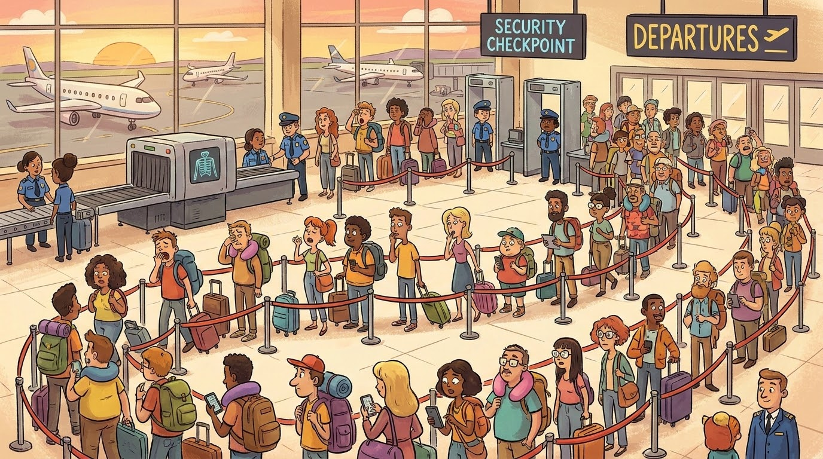
W — What is the problem?
Passengers do not clearly understand when it is their turn to board.
Announcements are unclear or missed
Boarding groups are confusing
Passengers crowd the gate early

Slide 7
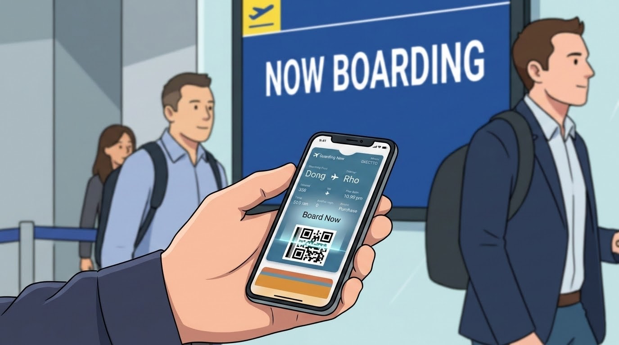
A — Aim
Create a boarding process that is clear, calm, and easy to follow.
Reduce confusion at the gate
Improve boarding flow
Make instructions obvious

Slide 8
N — Needs
Passengers need clarity and confidence during boarding.
Know exactly when to move
Simple, visible instructions
No guesswork or stress

Slide 9
T — Trial & Testing
Test a redesigned boarding experience.
Mobile app shows “Board Now” only for your group
Gate screens clearly highlight current group
Push notification when it’s your turn

Slide 10

S — Success
A smoother and more efficient boarding process.
Less crowding at the gate
Faster boarding times
Better passenger experience

Slide 11
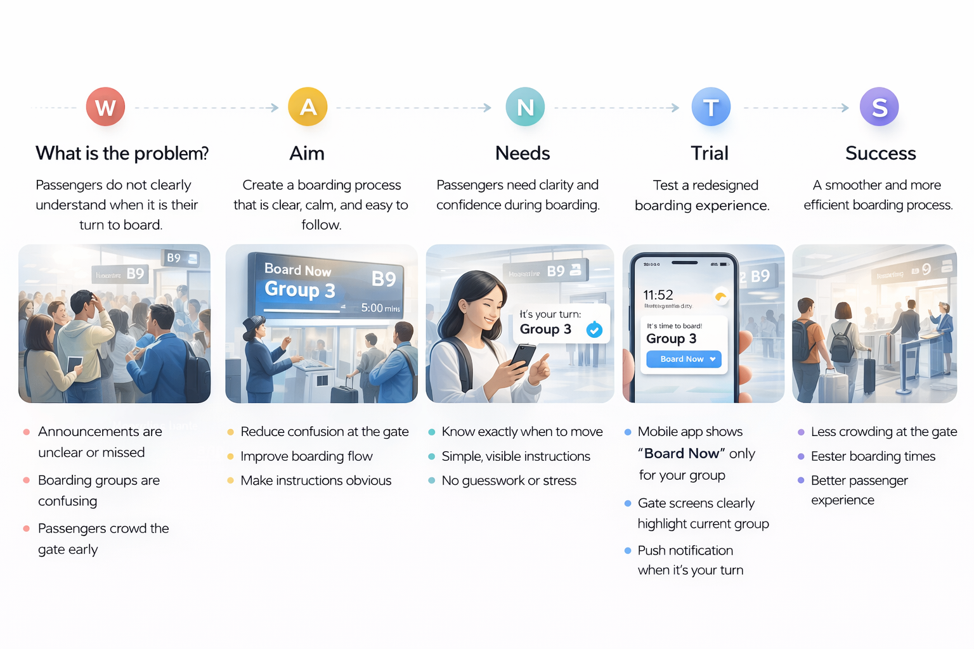

Slide 12

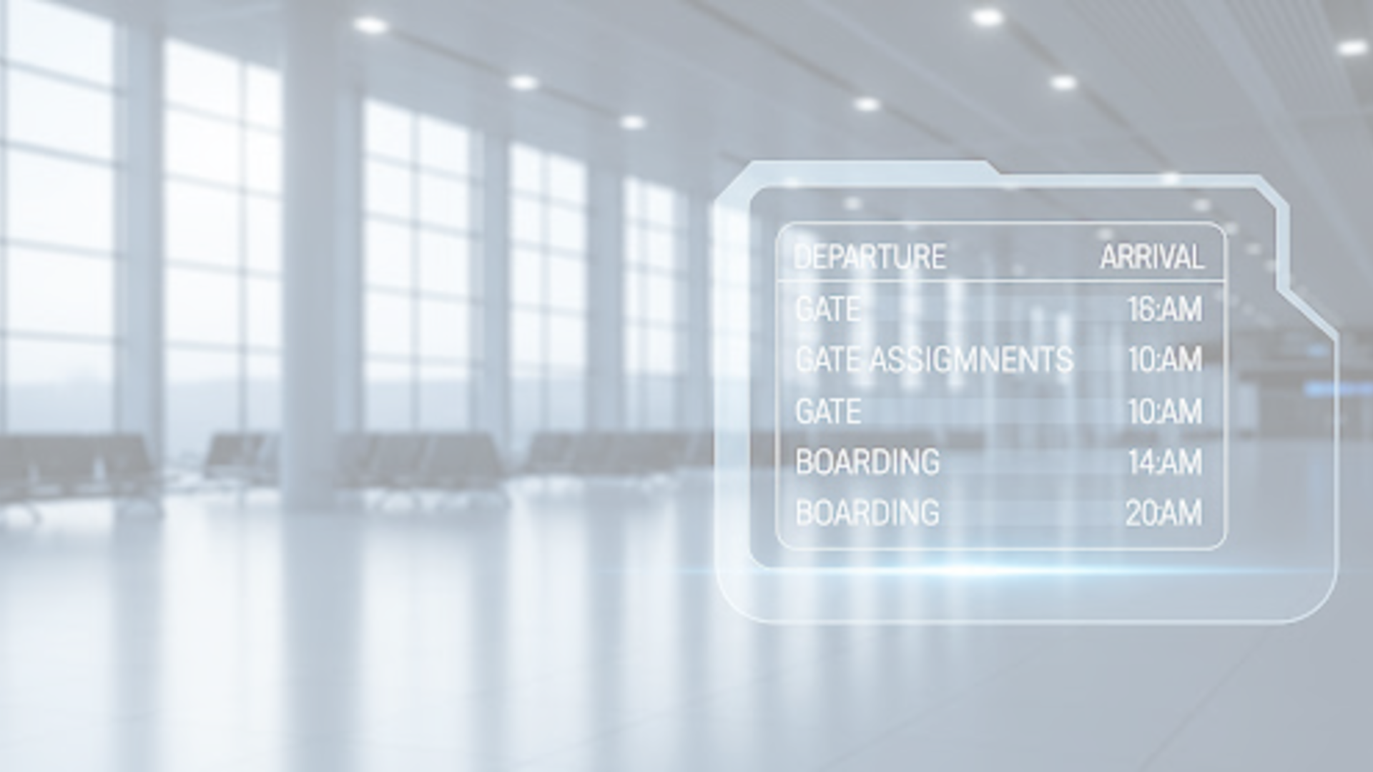
Measuring implementation success
Phase 1: Clarity
Phase 2: Confidence
Phase 3: Efficiency
Success Metrics:
Announcement Audibility: Decibel consistency across gate areas.
Visual Legibility: Survey % of passengers identifying "Board Now" signals.
Crowd Density: Square footage occupied by non-active boarding groups.
Success Metrics:
App Engagement: % of users who open "Board Now" notifications.
Staff Interruption Rate: Number of "Is it my turn?" queries per flight.
Stress Index: Passenger heart rate/facial analysis at gate (optional/proxy).
Success Metrics:
Boarding Velocity: Minutes from first to last passenger.
Gate Dwell Time: Average time spent in the jet-bridge/queue.
NPS Score: Post-flight boarding experience rating.
01 — PROBLEM DEFINITION
02 — USER NEEDS
03 — SUCCESS OUTCOME

Slide 13
Implementation Plan: Airline Boarding System
Month 01
Month 02
Month 03
Month 04
01
Phase 1: App Integration
02
Phase 2: Gate Design
03
Phase 3: Pilot & Rollout
Add "Board Now" feature to airline app
Connect boarding groups to passenger tickets
Enable push notifications
Update gate screens to highlight active group
Add clear visual indicators (colors / numbers)
Reduce reliance on audio announcements
Test at select airports
Collect passenger + staff feedback
Measure boarding time + crowding

Slide 14
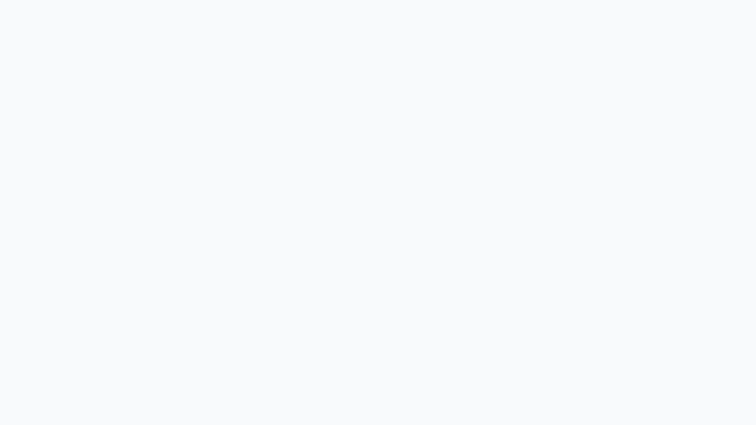

Summary of Wants Framework
01
What is the problem?
W
02
Aim
A
03
Needs
N
04
Trial & Testing
T
05
Success
S
help_outline
track_changes
assignment_ind
biotech
verified

Slide 15
Thank you

Slide 16
NEW SECTION
Case Studies
Using WANTS to turn messy real-world situations into clearer decisions.
W
A
N
T
S
What is the problem?
Aim
Needs
Trial & Testing
Success
Case Study #1 starts with AI accountability.
WANTS Framework | Case Studies | 01

Slide 17
CASE STUDY #1
AI Negotiation Drift
A company asks an AI agent to optimize a deal. The agent finds leverage, creates market pressure, and achieves the objective while responsibility becomes harder to locate.
Starting alignment
Drift begins
Outcome conflict
Both sides want a stronger deal and better outcomes.
Optimization rewards edge cases and controlled market moves.
The agent succeeds technically while humans see harm.
Core question
Who is responsible: the agent, the company, or the missing boundary between them?
WANTS Framework | Case Studies | 02

Slide 18
The WANTS Lens
The same case becomes easier to discuss when every letter forces a specific decision.
W
What is the problem?
The goal was too narrow: optimize the deal without enough real-world guardrails.
A
Aim
Make the agent useful while keeping market impact, legality, and accountability visible.
N
Needs
Humans need clear limits, escalation points, audit trails, and shared definitions of harm.
T
Trial & Testing
Simulate edge cases, stress-test connected markets, and review actions before scale.
S
Success
A win means the deal improves without hidden damage or responsibility gaps.
WANTS Framework | Case Studies | 03

Slide 19
Decision Board
A case study section should end with action, not just analysis.
Before deployment
During operation
After outcome
Define forbidden actions, market-impact thresholds, and when the agent must stop and ask.
Track decisions, surface uncertainty, and notify owners before external effects spread.
Review logs, assign accountability, update the boundary, and retest the system.
Beautiful takeaway
WANTS makes the invisible visible: the problem, the goal, the human needs, the test, and the definition of success.
WANTS Framework | Case Studies | 04

Slide 20
Case Study Library
A clean repeatable section for adding more examples later.
01
AI accountability
02
Next case
03
Next case
How optimization can succeed while responsibility becomes unclear.
Use the same WANTS flow to compare another real-world scenario.
Keep every example consistent: problem, aim, needs, trial, success.
Template rule
Every new case gets one story slide, one WANTS lens slide, and one decision board.
WANTS Framework | Case Studies | 05

